Slide 1
O.S. Security

Slide 2
The Security Problem
System secure if resources used and accessed as intended under all circumstances
Intruders (crackers) attempt to breach security
Threat is potential security violation
Attack is attempt to breach security
Attack can be accidental or malicious
Easier to protect against accidental than malicious misuse

Slide 3
Security Measure Levels
Impossible to have absolute security, but make cost to perpetrator sufficiently high to deter most intruders
Security must occur at four levels to be effective:
  Physical
    Data centers, servers, connected terminals
  Application
    Benign or malicious apps can cause security problems
  Operating System
    Protection mechanisms, debugging
  Network
    Intercepted communications, interruption, DOS
Security is as weak as the weakest link in the chain
Humans a risk too via phishing and social-engineering attacks
But can too much security be a problem?

Slide 4
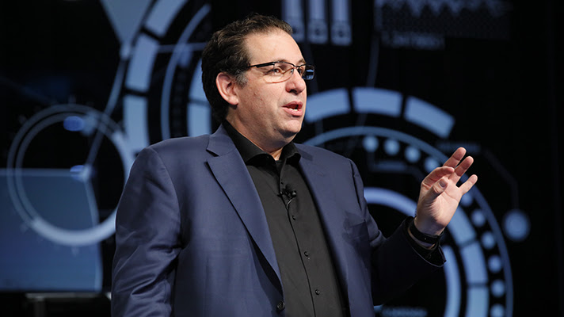
Kevin Mitnick : most notorious hacker

Slide 5
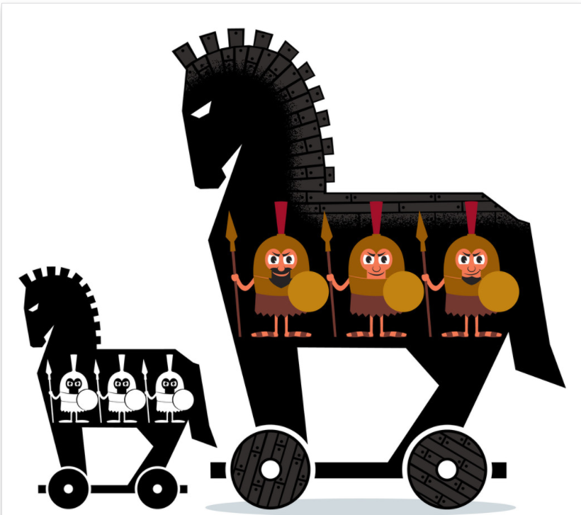
Program Threats
Many variations, many names
Trojan Horse
  Code segment that misuses its environment
  Exploits mechanisms for allowing programs written by users to be executed by other users
  Spyware, pop-up browser windows, covert channels
  Up to 80% of spam delivered by spyware-infected systems

Slide 6
Program Threats
Trap Door
  Specific user identifier or password that circumvents normal security procedures

Slide 7
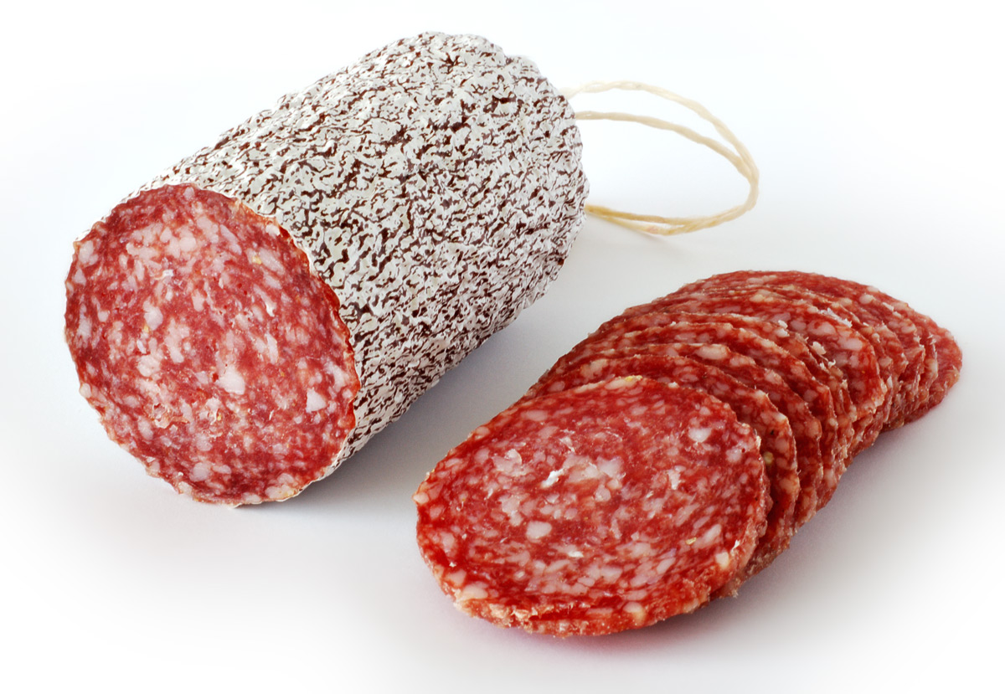
Salami Attack
Small attacks add up to one major attack that can go undetected due to the nature of this type of cyber crime.

Slide 8
Program Threats (Cont.)
Malware - Software designed to exploit, disable, or damage computer
Trojan Horse – Program that acts in a clandestine manner
  Spyware – Program frequently installed with legitimate software to display adds, capture user data
  Ransomware – locks up data via encryption, demanding payment to unlock it
Others include trap doors, logic bombs

Slide 9
Program Threats (Cont.)
Viruses
  Code fragment embedded in legitimate program
  Self-replicating, designed to infect other computers
  Very specific to CPU architecture, operating system, applications
  Usually borne via email or as a macro

Slide 10
The Threat Continues
Attacks still common, still occurring
Attacks moved over time from science experiments to tools of organized crime
  Targeting specific companies
  Creating botnets to use as tool for spam and DDOS delivery
  Keystroke logger to grab passwords, credit card numbers
Why is Windows the target for most attacks?
  Most common
  Everyone is an administrator
    Licensing required?

Slide 11
System and Network Threats
Worms – use spawn mechanism; standalone program
Internet worm
  Exploited UNIX networking features (remote access) and bugs in finger and sendmail programs
  Exploited trust-relationship mechanism used by rsh to access friendly systems without use of password

Slide 12
System and Network Threats (Cont.)
Port scanning
  Automated attempt to connect to a range of ports on one or a range of IP addresses
  Detection of answering service protocol
  Detection of OS and version running on system
  nmap scans all ports in a given IP range for a response
  nessus has a database of protocols and bugs (and exploits) to apply against a system

Slide 13
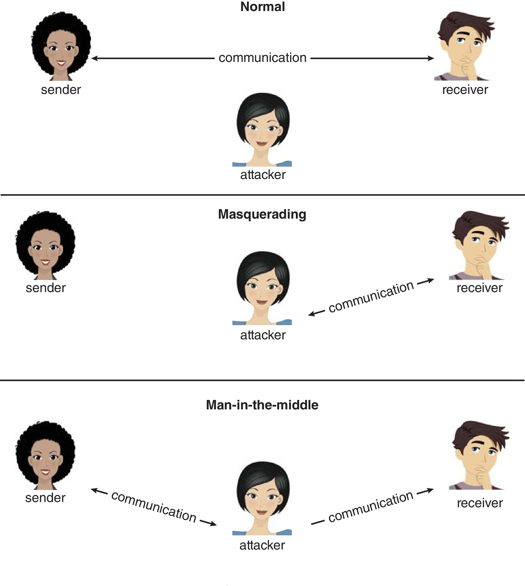
Standard Security Attacks

Slide 14
User Authentication
Crucial to identify user correctly, as protection systems depend on user ID
User identity most often established through passwords, can be considered a special case of either keys or capabilities
Passwords must be kept secret
  Frequent change of passwords
  History to avoid repeats
  Use of “non-guessable” passwords
  Log all invalid access attempts (but not the passwords themselves)
  Unauthorized transfer
Passwords may also either be encrypted or allowed to be used only once
  Does encrypting passwords solve the exposure problem?
    Might solve sniffing
    Consider shoulder surfing
    Consider Trojan horse keystroke logger
    How are passwords stored at authenticating site?

Slide 15
Passwords
Encrypt to avoid having to keep secret
  But keep secret anyway (i.e. Unix uses superuser-only readably file /etc/shadow)
  Use algorithm easy to compute but difficult to invert
  Only encrypted password stored, never decrypted
  Add “salt” to avoid the same password being encrypted to the same value
One-time passwords
  Use a function based on a seed to compute a password, both user and computer
  Hardware device / calculator / key fob to generate the password
    Changes very frequently
Biometrics
  Some physical attribute (fingerprint, hand scan)

Slide 16
Security Defenses Summarized
By applying appropriate layers of defense, we can keep systems safe from all but the most persistent attackers. In summary, these layers may include the following:
  Educate users about safe computing—don’t attach devices of unknown origin to the computer, don’t share passwords, use strong passwords, avoid falling for social engineering appeals, realize that an e-mail is not necessarily a private communication, and so on
  Educate users about how to prevent phishing attacks—don’t click on email attachments or links from unknown (or even known) senders; authenticate (for example, via a phone call) that a request is legitimate
  Use secure communication when possible
  Physically protect computer hardware
  Configure the operating system to minimize the attack surface; disable all unused services
  Configure system daemons, privileges applications, and services to be as secure as possible

Slide 17
Security Defenses Summarized (cont.)
  Use modern hardware and software, as they are likely to have up-to-date security features
  Keep systems and applications up to date and patched
  Only run applications from trusted sources (such as those that are code signed)
  Enable logging and auditing; review the logs periodically, or automate alerts
  Install and use antivirus software on systems susceptible to viruses, and keep the software up to date
  Use strong passwords and passphrases, and don’t record them where they could be found
  Use intrusion detection, firewalling, and other network-based protection systems as appropriate
  For important facilities, use periodic vulnerability assessments and other testing methods to test security and response to incidents

Slide 18
Security Defenses Summarized (cont.)
  Encrypt mass-storage devices, and consider encrypting important individual files as well
  Have a security policy for important systems and facilities, and keep it up to date

Slide 19
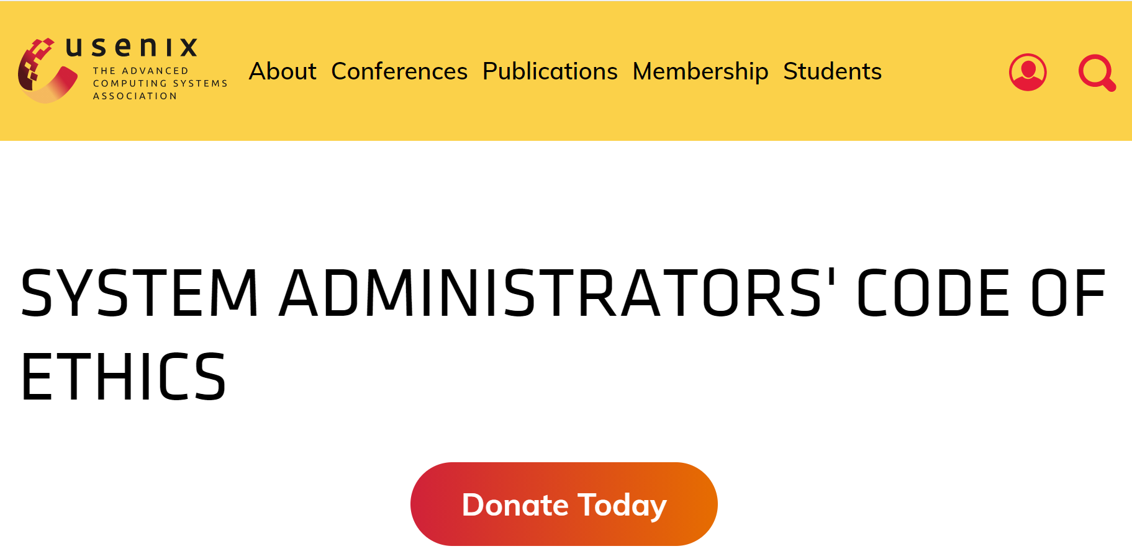

Slide 20
System Administrator Code of Ethics
I will access private information on computer systems only when it is necessary in the course of my technical duties.
I will maintain and protect the confidentiality of any information to which I may have access, regardless of the method by which I came into knowledge of it.
I will strive to ensure the necessary integrity, reliability, and availability of the systems for which I am responsible.
https://www.usenix.org/system-administrators-code-ethics

Slide 21
กรณีศึกษา
เพื่อนสนิทมาขอร้องคุณที่เป็น system admin ให้เปิดอ่านอีมลของแฟนเขาในระบบที่คุณดูแล เพราะสงสัยว่า แฟนเขาจะติดต่อกับผู้อื่นหรือนอกใจ
จงใช้ System Admin Code of Ethics ช่วยในการตัดสินใจของคุณ

